Slide 1
Stock Market Price Prediction Using
Machine Learning In Volatile Market
Name -: Ranshul Kumar Jayant
Roll No. -: 2021380
Section -: D
Branch -: Computer Science
Mentor -: Mr. Kireet Joshi

Slide 2

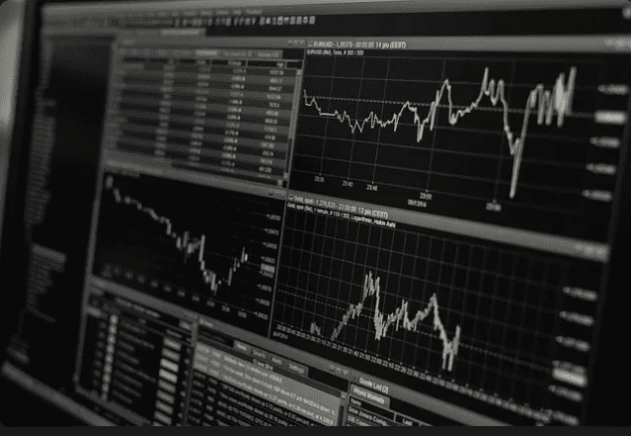
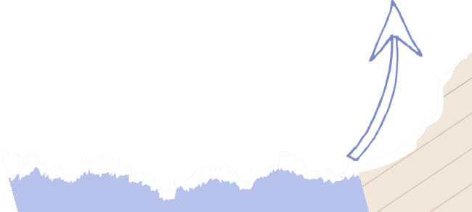
INTRODUCTION AND PROBLEM STATEMENT
Stock market provides a venue where companies raise capital by selling shares or equity, to investors. In today’s world of high inflation rate every person should invest there money in the forum where it can beat the rate of inflation and give decent return to the investor and stock market is one of them. But stock market is the challenging forum and it also require a lot of brainstorming. Since it is very volatile in nature, so it is very difficult to predict and it is also very risky to invest in stock market without any prior knowledge.

Slide 3


AIM
The main aim of the project is to build a model that guides the person to invest in a particular stock in which is less risky. The different machine learning algorithm is used to train the model to give the better result. The model is trained to give the best possible prediction to the user to maximize the profit.

Slide 4
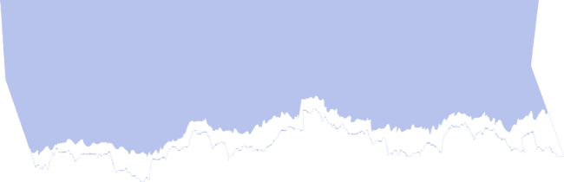


METHODOLOGY
The Methodology includes the various steps which are important for model training and processing data .There are python libraries such as matplotlib, pandas , numpy and sklearn which are used in all these tasks.
Data Collection
Data Cleaning And Preprocessing
Model Training

Slide 5



DATA COLLECTION
Source of Data Collection
We have collected data from the official website of Yahoo finance .
Data Points -: Opening and closing prices, high and low prices, trading volumes.
We have downloaded csv file of Tata Consultancy Services (TCS) from 16-01-2004 to 16-04-2024.
The TCS file contain total 5018 data fields and these data fields are divided into 80 : 20 ratio in which 80% of data is used as training data and 20% is used as testing data.

Slide 6
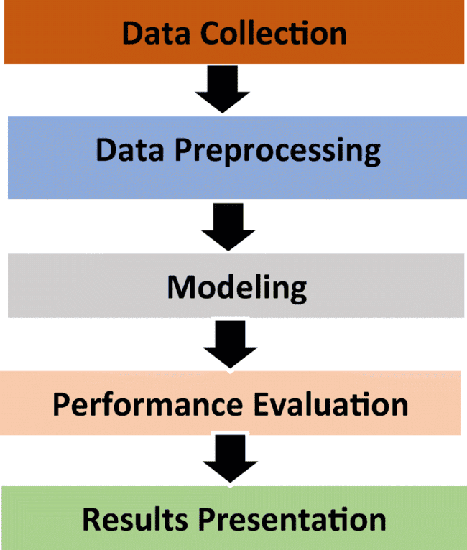

DATA CLEANING AND PREPROCESSING
DATA CLEANING -: The null values are removed from the dataset by using the dropna function of pandas library.
DATA PREPROCESSING -:
Moving average of 200 days is taken to split it into the x_train and y_train.
Normalization: Scaling numerical features to a standard range to ensure they contribute equally to the model . MinMaxScaler from sklearn library is used for normalization of data.

Slide 7
MODEL TRAINING
Various machine learning models are considered for stock price prediction, each with its strengths and weaknesses:
LONG-SHORT TERM MODEL --: LSTM is the special type of RNN that solves traditional RNN’s short term memory problem. It is architecture to better capture dependencies in sequential data such as time series data, language or stock price. . It is best suited for handling long term dependencies and overcoming the vanishing gradient problem of RNN.
LINEAR REGRESSION --: Linear Regression basically means best fit according to the data points give in the table . It works on the mathematical formula . It is simple and fast to apply but it does not capture the complex relation between data.
Y=MX + C

Slide 8

RESULTS AND DISCUSSION
The dataset was split into training (80%) and testing (20%) sets.
The LSTM MODEL was trained for 50 epochs .
The prediction was made on the test dataset (x_test) using the LSTM model.
The values of y_predict and y_test is multiplied by scaler_factor to obtain the actual values.
The actual closing prices during the testing period and predicted closing prices (Predictions) overlaid on the same graph.

Slide 9
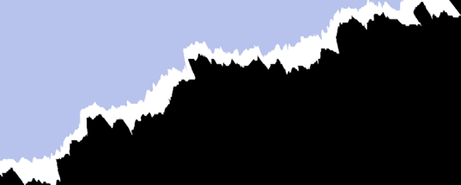
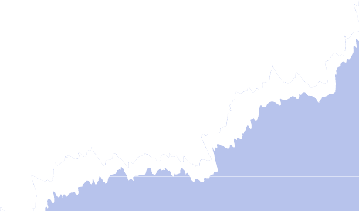
In Linear Regression model , the data is split using the train_test_split from sklearn library.
The sklearn library is used to import the linear regression model.
The prediction was made on the test dataset (x_test) using the Linear regression model. The y_test is treated as the actual price .
The Mean Absolute Error of LSTM is 52.56 and of Linear regression is 51.06 which are approximately same but the LSTM Model can work more efficiently than linear regression by modifying it.
LSTM can handle the complex relation between the data which Linear regression cannot.
Linear regression can perform better on short range of data which does not contain any complex relation.

Slide 10
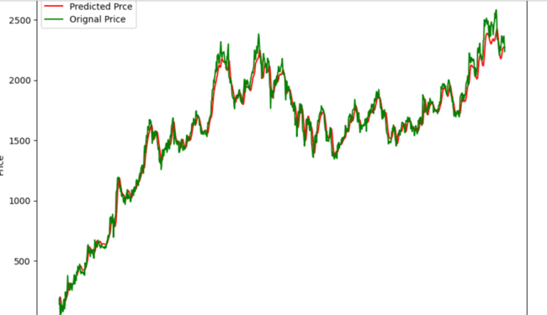
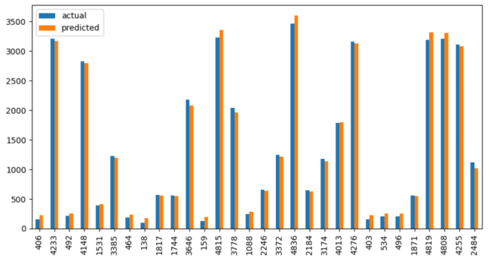
GRAPH OF LSTM AND LINEAR REGRESSION
LSTM ACTUAL VS PREDICTED PRICE
LINEAR REGRESSION ACTUAL VS PREDICTED PRICE

Slide 11


THANK
YOU

